Slide 1
Diocese of Southwark Press & Communications
Wendy S Robins
Director of Press and Communications
and Bishop’s Press Officer

Slide 2
Richmond and Barnes Deanery
22 January 2019
St Richard, Ham

Slide 3
Aim of the Session
To help parishes in the Deanery to think strategically about their use of methods of
communication
To consider the best mode of communication for the tasks involved
To identify where Press and Communications can offer help

Slide 4
Deanery Survey
‘All in all you are great communicators
but there is always more to learn’
(Richmond and Barnes Churches Communications Survey 2018)

Slide 5
Over to you
What would you like to take
away from this session?

Slide 6
Choosing the medium
It is always important to think about your target audience and make sure that you are using the right one for them
Older people use Facebook
Those in the congregation will like a mixture of paper and web based/email stuff
Twitter is good for drawing people in, discussions and immediate news
Instagram tends to have a younger audience. Captions under photos give the opportunity to tell a story.

Slide 7
Traditional news
Remember that there is still a place for newspapers!

Slide 8
What is ‘news’ ?
News is NOT:
Normal
Everyday happenings
News IS:
Fast-moving
Changeable
Topical
Notes:
WSR/SH

Slide 9
Or…
‘Dog Bites Man’
is not news…
‘Man Bites Dog’
certainly is!
Notes:
WSR/SH

Slide 10
What is ‘news’?
Most news comes from four basic reasons:
People or organisations doing things
People or organisations having things done to them
Unusual events or actions
Conflict, scandals, disasters (more on this later.....)
Notes:
WSR/SH

Slide 11
Getting the story noticed
Make it timely and topical Christmas and Summer are traditionally quiet times for local media… … and the Church has plenty going on at Christmas and in the summer!
Make it relevant
Local people love to read about their own community
Notes:
WSR/SH

Slide 12
It’s a race
All papers/programmes have to fill a certain amount of space
Your story/picture/news item will get in if it is well presented and on time
Notes:
WSR/SH

Slide 13
Know the people
Get to know the local papers and radio stations
Get to know the editors especially the paper’s main editor and the news editor (assuming that there are a few staff)
Ask them what will get in
Be sure to know the best format for them
Notes:
WSR/SH

Slide 14
Getting stories used
Often now reporters will pick stories up from blogs and tweets as well as press releases
So think about how best to get the message out there
Notes:
WSR/SH

Slide 15
Getting stories used
We tweet a link to our press release on the web
We also tweet a link to our Flickr stream and Facebook
Make sure you have permission to use the photographs you send
Notes:
WSR/SH

Slide 16
What is the story?
Some ideas of events or activities the media might be interested in:
A visit from the Bishop
Special events
Fundraising initiatives and stunts
Notes:
WSR/SH

Slide 17
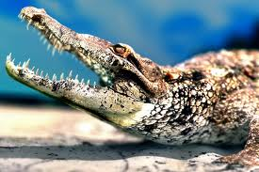
The News Release
Make it short and snappy!
Notes:
WSR/SH

Slide 18
Writing a good Press Release
Make sure your first paragraph contains the answers to these five questions:
- What is happening ?
- Where is it taking place ?
- Why is it happening ?
- When is it happening ?
- Who is involved ?
Notes:
WSR/SH

Slide 19
Writing a good Press Release
Keep your sentences short and your language simple. Avoid lengthy theological phrases or explanations!
Remember that editors who are short of time usually edit from the bottom
Have a good picture to go with it
Notes:
WSR/SH

Slide 20
Not like this….
Notes:
WSR/SH

Slide 21
But like this!
Notes:
WSR/SH

Slide 22
Writing a good Press Release
Try to include a quote
No longer than one side of A4 paper – double spaced
Don’t forget contact details
Notes:
WSR/SH

Slide 23
Notes for Editors
Notes for Editors
Gardening Against the Odds awards are sponsored by the Conservation Foundation http://www.conservationfoundation.co.uk/
More information on the work of St Mungo’s can be found at http://www.mungos.org/
ends
More information from
Wendy S Robins tel 020 7939 9436 / 07831 694021

Slide 24
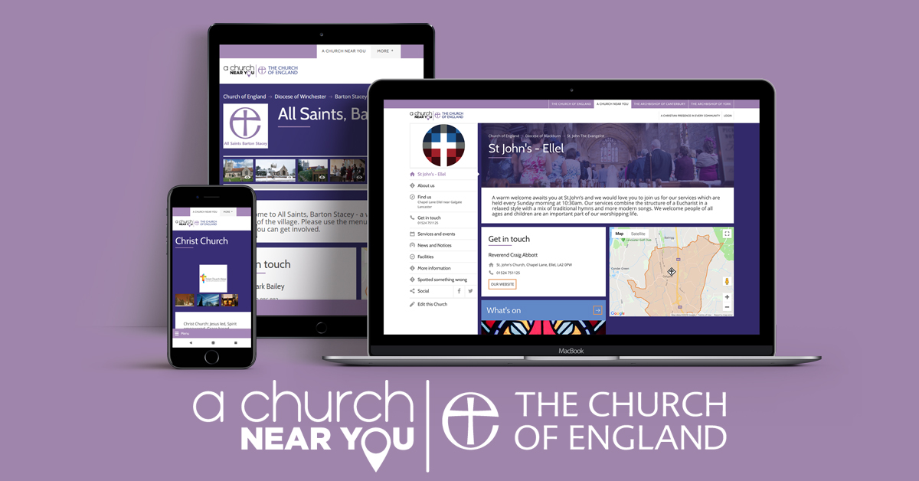

Slide 25
10million page views a year
Over 80% first time visitors
Often the first Google result
Mobile-friendly
Services, events, maps, contact details
New functionality: custom domain & analytics

Slide 26
Websites
3-click rule
Don’t overcomplicate
Why am I here?

Slide 27
What do you really need?
Mobile has overtaken desktop in many metrics
Maximise usability with a responsive or mobile-first design
Small-group discussion

Slide 30
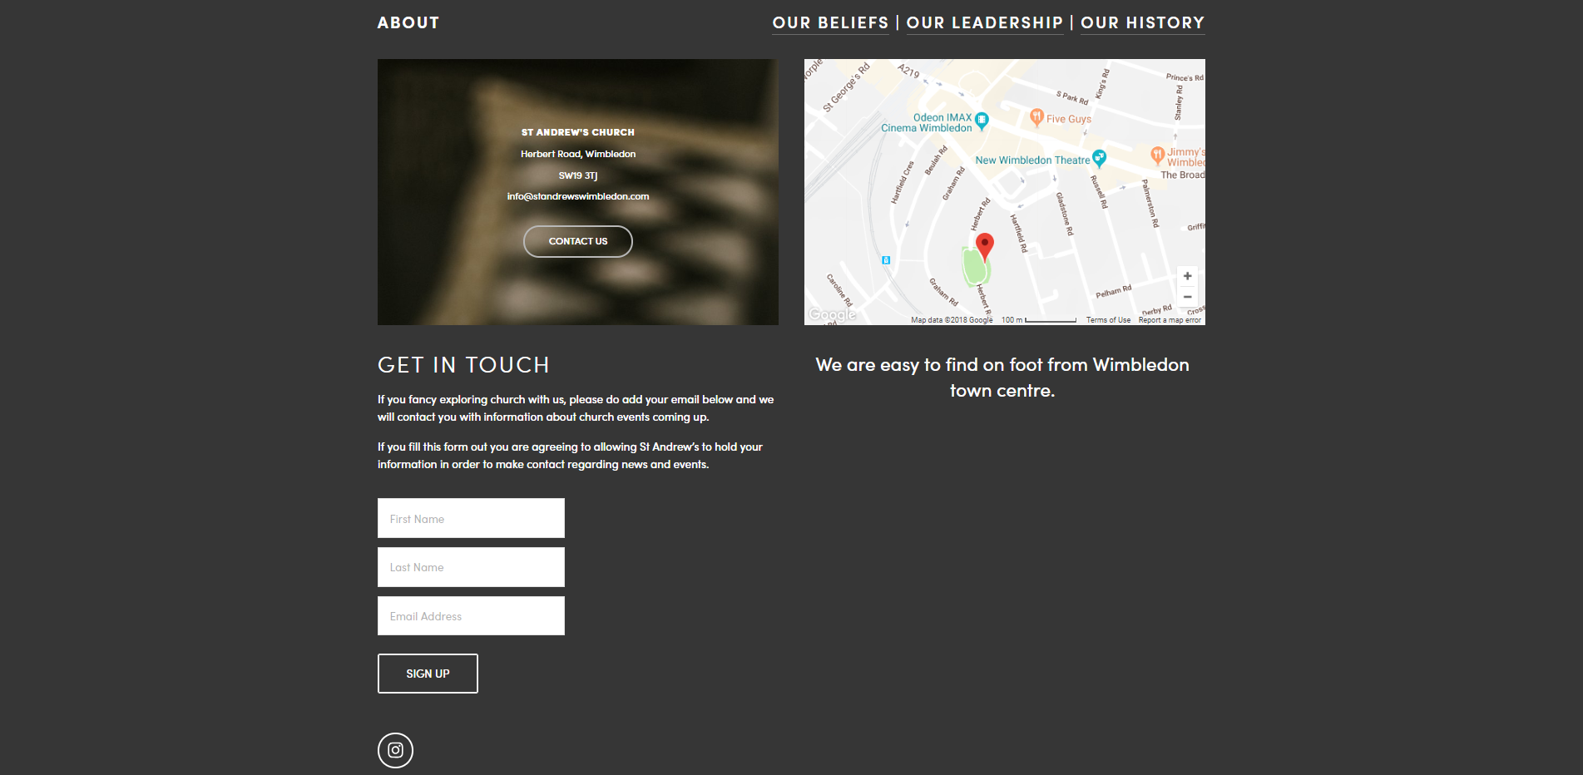

Slide 31
Be consistent & informative
Think about image quality vs download speed
Don’t have autoplay/flash
Avoid the use of "Click here" when writing text for hyperlinks
If you’re on Social Media – make it obvious
Keep the info on social media pages up to date, even if you’re not regularly active, people will search for you

Slide 32
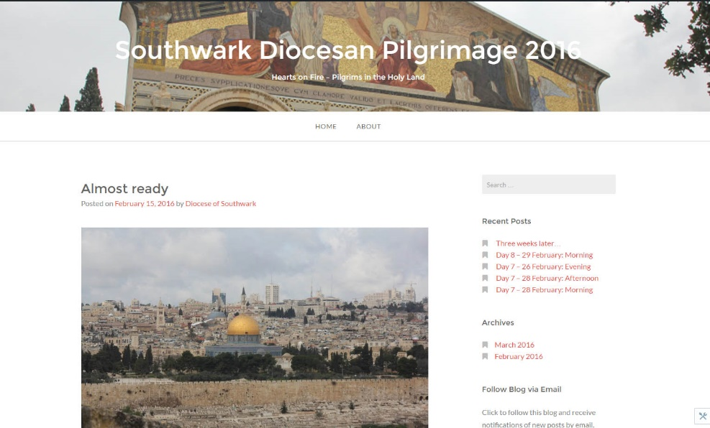
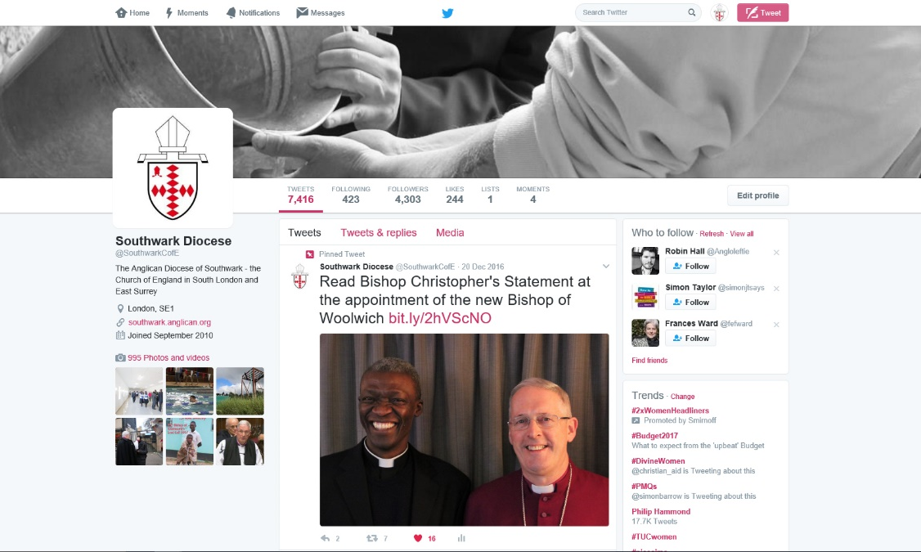
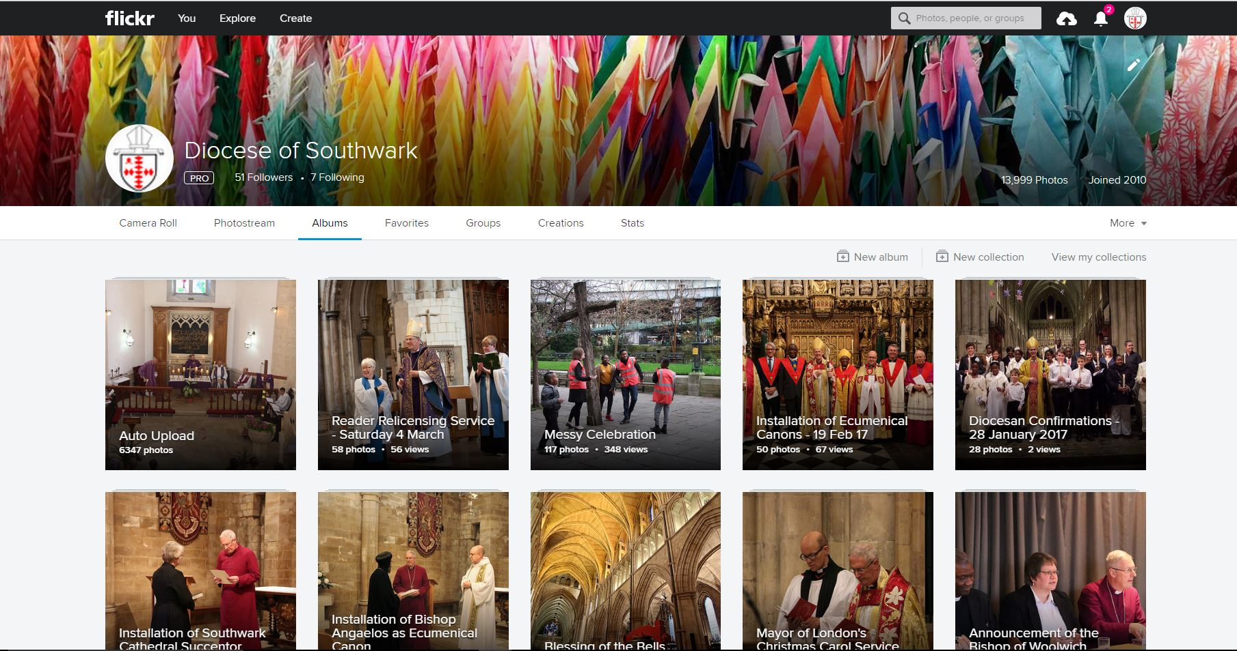
Southwark’s media presence
Notes:
WSR/SH

Slide 33
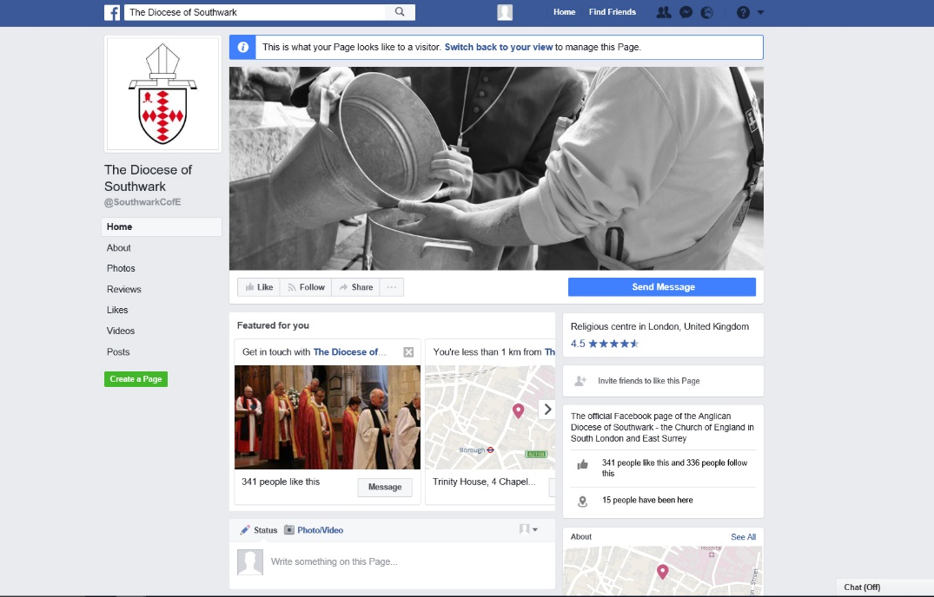
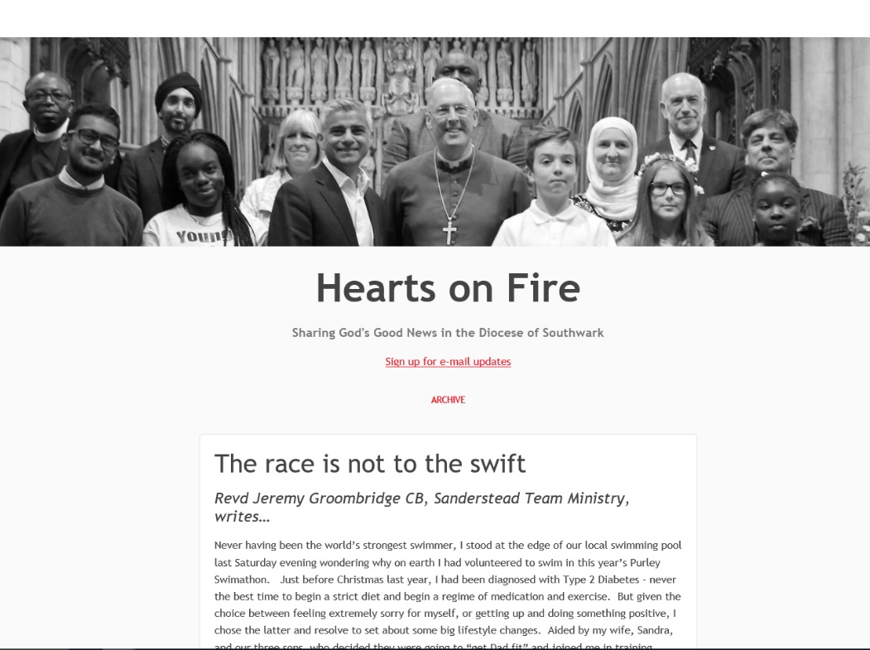
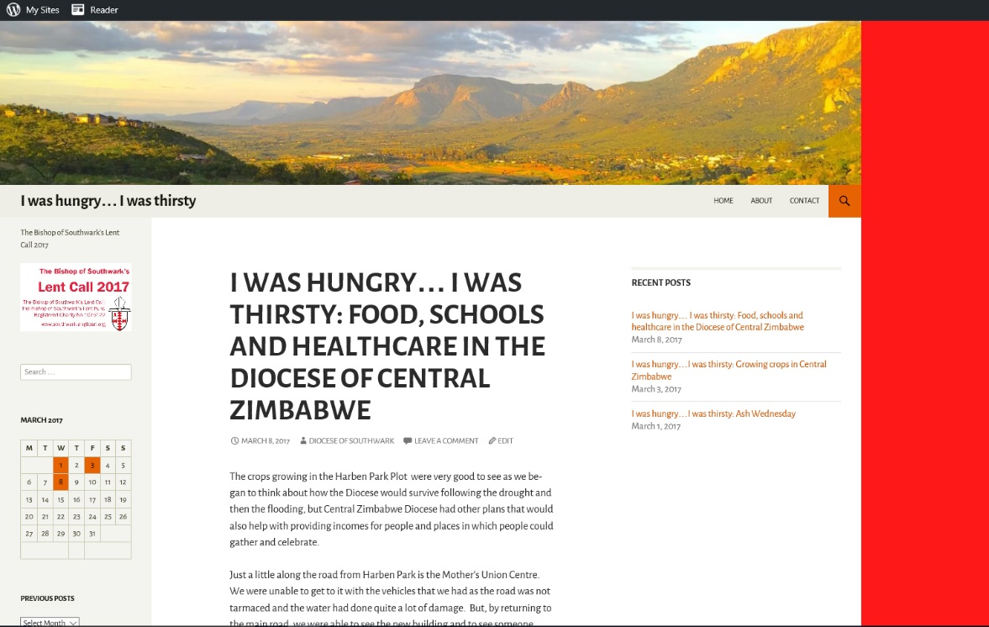
Southwark’s media presence
Notes:
WSR/SH

Slide 34
Blogging and tweeting
What to blog/tweet
When
What to say (and what not to say)!

Slide 35
Twitter
335million MAU, 30% use it daily (13million UK users)
500million tweets sent per day
80% mobile
2billion search queries per day
74% of users say they use the network to get their news

Slide 36
Church of England defends prayer tweet
for Richard Dawkins after stroke
Feb 2016

Slide 37
'Going to Africa. Hope I don't get AIDS. Just Kidding. I'm White!'
PR exec on trip to Africa

Slide 38
Royal Wedding: Bishop predicts Prince William's marriage to Kate Middleton will only last seven years
Telegraph Nov 2010
Notes:
Share Pete Broadbent story and how it unfolded during November Synod

Slide 39
Facebook
1.47b daily desktop, 1.57b daily mobile
55m status updates a day
Nearly 80% of internet users have a Facebook account
62% of internet users over 65 have a Facebook account
‘Like’ button has been pressed 1.13 trillion times

Slide 40
Think of it this way
If you would not say what you are about to blog or tweet or put on Facebook to everyone in this room in exactly the same way as you are about to say it

Slide 41
Don’t do it!

Slide 42
Instagram
1b MAU
500m DAU
50b photos shared
72% of teenagers use Instagram
59% of internet users 18-29 and 33% 30-49 use IG
Users engage more on weekdays
Pizza is the most Instagrammed food globally

Slide 43
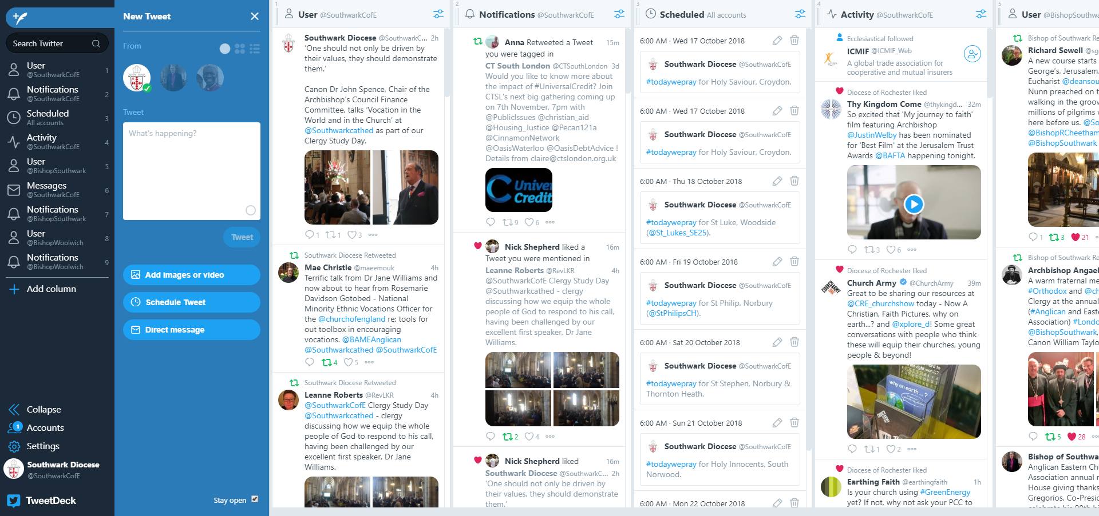
tweetdeck.twitter.com

Slide 44
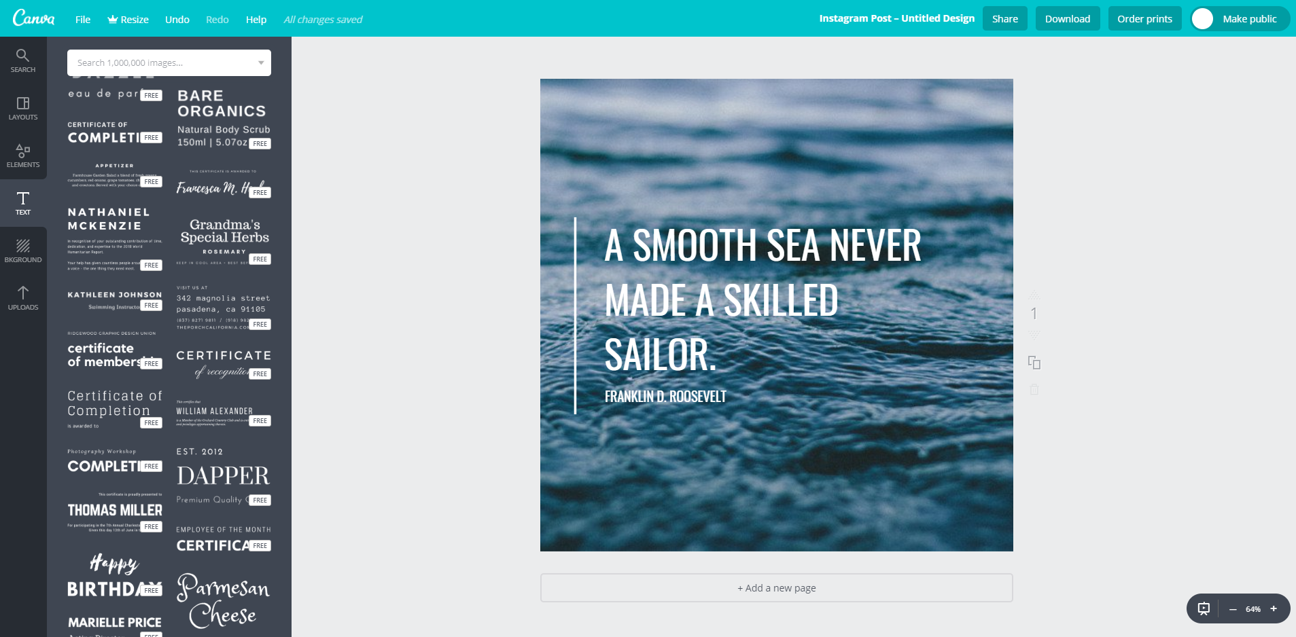
canva.com

Slide 45
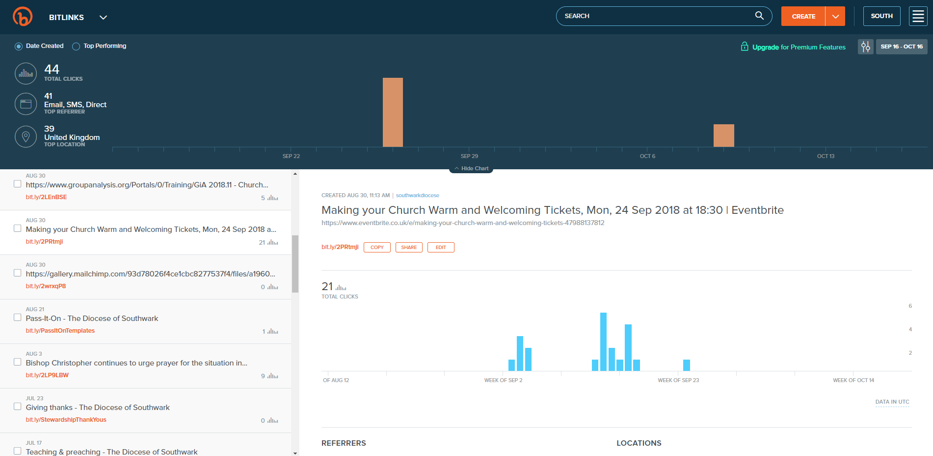
bitly.com

Slide 46
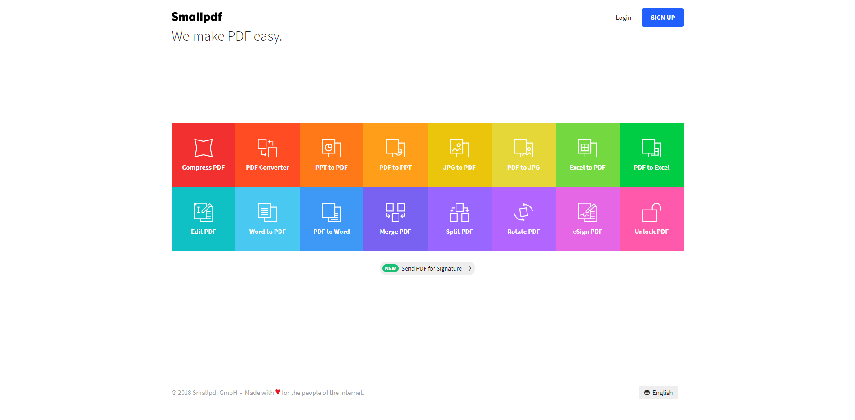
smallpdf.com

Slide 47
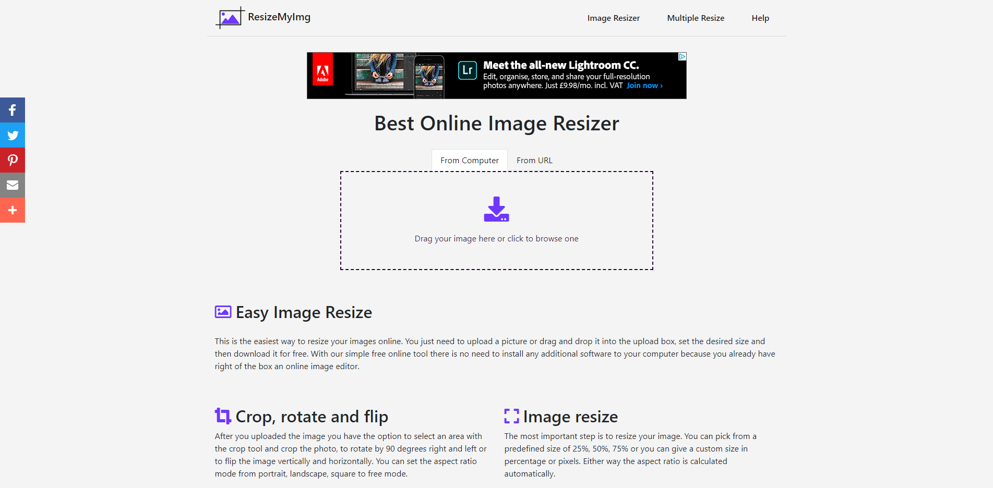
resizemyimg.com

Slide 48
wetransfer.com

Slide 49
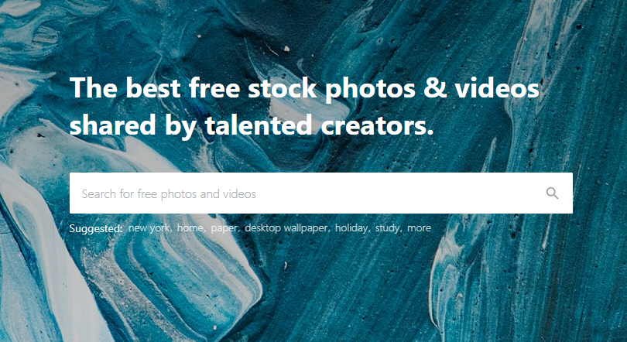
pexels.com

Slide 50
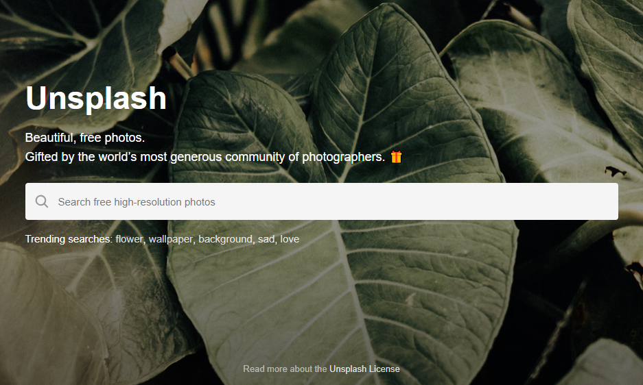
unsplash.com

Slide 51
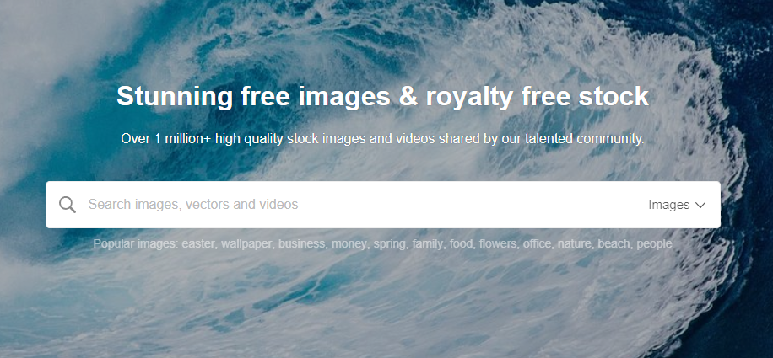
pixabay.com

Slide 52
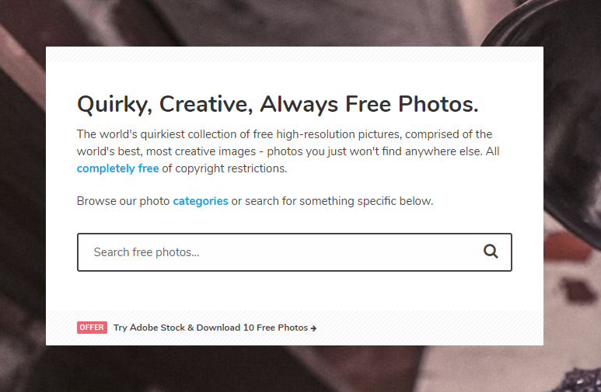
gratisography.com

Slide 53
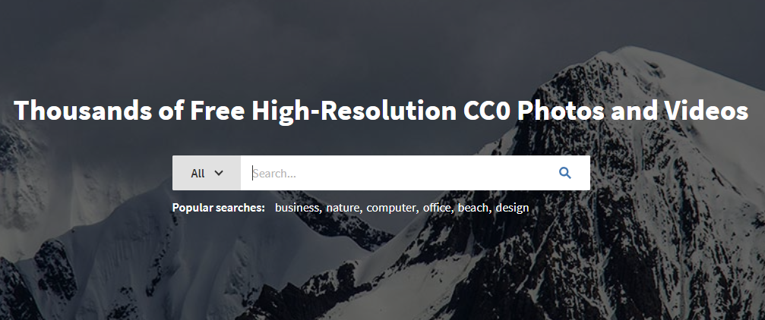
isorepublic.com

Slide 54
Dealing with bad news
As we all know, bad news probably sells more papers than good
So what do you do if the local media get wind of a negative news story concerning the parish?
Notes:
WSR/SH

Slide 55
Firstly – don’t panic! Alert your Diocesan Communications Team
They will work with you on a plan of action to deal with media enquiries – including helping you to produce a statement that you can give to the media if necessary (we would actually give it for you!)
Notes:
WSR/SH

Slide 56
Don’t allow yourself to be bullied
You do not have to answer their questions immediately
Notes:
WSR/SH

Slide 57
Make a note of the journalist’s enquiry and any questions they have, as well as their contact details and the deadline they are working to. Offer to call them back within that deadline with your response. This gives you time to work out what you want to say, and to clear it with relevant third parties.

