Slide 1
JUSTICE:PEACE:CREATION
Challenging unjust structures
Presented by the Justice, Peace and the Integrity of Creation Department
Richmond & Barnes Deanery Synod
5th June 2019

Slide 2
Southwark Diocese Vision
A fruitful future in which we will see:
Growing churches
Deepening discipleship
Generous giving and prayer
Justice and peace built up and violence challenged
Shared commitment to the integrity of creation

Slide 3
JPIC
Department of Justice, Peace and the Integrity of Creation
Director: Revd Canon Dr Rosemarie Mallett, rosemarie.mallett@southwark.anglican.org
Diocese
Ensuring the Diocese as a whole supports social justice issues.
Supporting Mission Action Plans
Feeding local priorities into wider diocesan planning.
Monitoring and evaluations
Public square
Supporting the Diocesan Bishop with briefings on public policy/ social justice issues.
Publishing articles and papers on social justice issues.
Connecting with local and national politicians, social justice activists and other organisations
Working strategically with civil society
Parishes
Supporting individual parishes to tackle social justice issues through:
Listening to priorities
Providing resources
Putting on training and events
Connecting people
JPIC working in three directions
Diversity and Inclusion
Contact: Revd Canon Dr Rosemarie Mallett
Telephone: 02079399411
Email: rosemarie.mallett@southwark.anglican.org
Twitter: @Rosemariemallet
Welcoming ‘the stranger’
Refugee coordinator
Contact: Joanne McCrone (part time)
Telephone: 02079399418
Email: joanne.mccrone@southwark.anglican.org
Twitter: @Joontheweb
Poverty
Together Southwark
Contact: Nelly Misenga (full time)
Telephone- 02079399415
Email- nelly.misenga@southwark.anglican.org
Twitter- @TogSouthwark
JPIC
The department’s aim is to support the Diocese and its churches to fulfil the 3rd, 4th and 5th marks of mission:
Tend: Respond to need with loving service.
Transform: Change society’s unjust structures.
Treasure: Safeguard the integrity of creation.
(Adapted by the Diocese of Southwark
in ‘Living the Marks of Mission’)
Inter-faith
Contact: Siriol Davies (part time)
Email: Siriol.davies@southwark.anglican.org
Twitter: @Siriol_davies
Public Policy
Contact: Elizabeth Booker (full time)
Telephone- 02079399412
Email- elizabeth.booker@southwark.anglican.org
Twitter- @newhammum
Inc.
Mental Health
Prisons
Social Cohesion
Accessibility and Disability
Contact: Revd Tim Goode
Email: revtimgoode@gmail.com
Twitter: @revtimgoode
Environment
Contact: Sue Mallinson (volunteer)
Email: suemalli@Tiscali.co.uk
Notes:
Who we are and how to contact us

Slide 4
The 5 Marks of Mission
Tell: to proclaim the Good News of the Kingdom.
Teach: to baptise and nurture new believers.
Tend: to respond to human need by loving service.
Transform: to transform unjust structures of society.
Treasure: to safeguard the integrity of creation.

Slide 5
“He has told you, O mankind, what is good; and what does the Lord require of you but to do justice, and to love kindness, and to walk humbly with your God?”
Micah 6:8

Slide 6
Gov.
Health
Media
Markets
Ed.
Social Norms
Religion
Law
Families
Money
What are the structures in our society
Social structure is the organized set of social institutions and patterns of institutionalized relationships that together compose society….Social structure is both a product of social interaction and directly determines it….they are always present and affect all dimensions of human experience in society.’​’
The Concept of Social Structures in Sociology
By Ashley Crossman
Notes:
Sociological definition
It is helpful to think about social structure as operating on three levels within a given society: the macro, meso, and micro levels.
Social Structure: The Macro Level of Society
When sociologists use the term "social structure" they are typically referring to macro-level social forces including social institutions and patterns of institutionalized relationships. The major social institutions recognized by sociologists include family, religion, education, media, law, politics, and economy. These are understood as distinct institutions that are interrelated and interdependent and together help compose the overarching social structure of a society.
Social Networks: The Meso Level Manifestation of Social Structure
Sociologists see social structure present at the "meso" level —between the macro and the micro levels—in the social networks that are organized by the social institutions and institutionalized social relationships described above. For example, systemic racism fosters segregation within U.S. society, which results in some racially homogenous networks. The majority of white people in the U.S. today have entirely white social networks.
Our social networks are also a manifestation of social stratification, whereby social relations between people are structured by class differences, differences in educational attainment, and differences in levels of wealth.
In turn, social networks act as structuring forces by shaping the kinds of opportunities that may or may not be available to us, and by fostering particular behavioral and interactional norms that work to determine our life course and outcomes.
Conclusion
In conclusion, social structure is composed of social institutions and patterns of institutionalized relationships, but we also understand it as present in the social networks that connect us, and in the interactions that fill our everyday lives.
Updated by Nicki Lisa Cole, Ph.D.

Slide 7
What makes a structure unjust?
Notes:
Justice= living a right relationship with God, one another and creation.
Justin Welby- Justice is God’s nature but it is our responsibility, 2016

Slide 8
Why we challenge unjust structures
When we talk about social justice, we mean God's original intention for human society:
Kindness (charitable works)
Basic Needs are met.
Human flourishing.
Peace.
Justice
Identifying the root causes.
Advocate systemic change.
Witness and work to remove barriers to justice.
A message that doesn’t proclaim our radical liberation through Jesus Christ from every configuration of sin including structural, limits the stature of our Deliverer.
Notes:
The measure of being a good disciple is not just the love of God but also the love of our neighbour.
Charity- spending time elevating the effects
Justice- spending time elevating the causes
Justice is an extension of Charity, ensuring our societal structures reflect our love of people. The third Mark of Mission leads onto the fourth- from loving service to challenging unjust structures.
Only focusing on loving kindness not only breaks the Micha verse up, separating justice and kindness it is like spending all our saving drowning people from a river without ever looking up to see why they keep falling in.

Slide 9
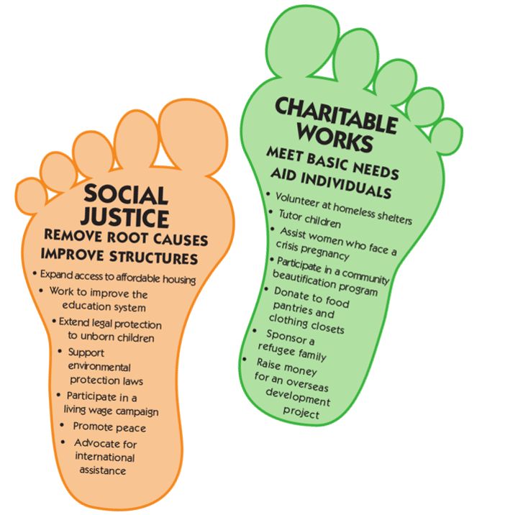
We need both feet to walk
#TendTransformTreasure
Notes:
The 5 Marks of Mission, how they fit together
Segment from the USPG lent readings:
‘As Christians we are called to speak up and to speak out.
This prophetic voice arises in the heart of God and flows out into all of Creation. It is most fully expressed in the life and teaching of Jesus Christ, and it is through the Holy Spirit that we are drawn deeper into the prophetic heart of God.
To be prophetic is to ‘tell forth’, which involves challenging injustice and standing up for the poor, the widow, the orphan and the foreigner. We know that the Old Testament prophets were often unpopular because they challenged the people to remember justice and mercy and walk humbly with God.’
Challenging the status quo is not radical but it is resisted because the people in power like the status quo, it is what keeps them in power. Jesus fed the poor and healed the blind but he also denounced the oppression by religious leaders, included those who were excluded and challenged the corruption of money.
Challenging unjust structures is one of he 5 marks of mission, so it has to be essential to mission in the same way as preaching, nurturing and charity are.

Slide 10
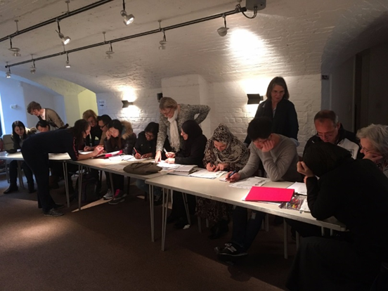
Example
English as a second language
ESOL Provision
Jo McCrone
Refugee Response Coordinator
Notes:
Theoretical example about how public policy changes create changes in peoples quality of life (an example you might find could be…)
Deuteronomy 15- …open your hand to the poor and needy
Mathew 25- What you did for the least of these…
Timothy- support the real widows, those with no one.
Social structures (good and bad)
Social norms--------- less family living together + ability for wider group to chase ambition
Family finances------ necessity for more full time work of adult children + expectation on material possession/ standard of living
Gov. policies --------- Austerity + welfare/ social care policies
Markets -------------- commodification of care/ competition driving up standards/ devaluing care through low wages
From the Guardian Feb 2019
Age UK
54,000 people have died while waiting for a care package since the government first said in March 2017 it would publish its social care green paper, which has since been delayed several times.
Tightening eligibility for council-funded social care meant 626,701 people – 895 a day – have had requests for social care refused since March 2017.
More than a million older people had developed an unmet care need in that time, such as needing help with washing or dressing, it added.
Depending on lots of factors including your political/ philosophical/ theological/ moral perspectives on a number of issues will determine how you respond.

Slide 11
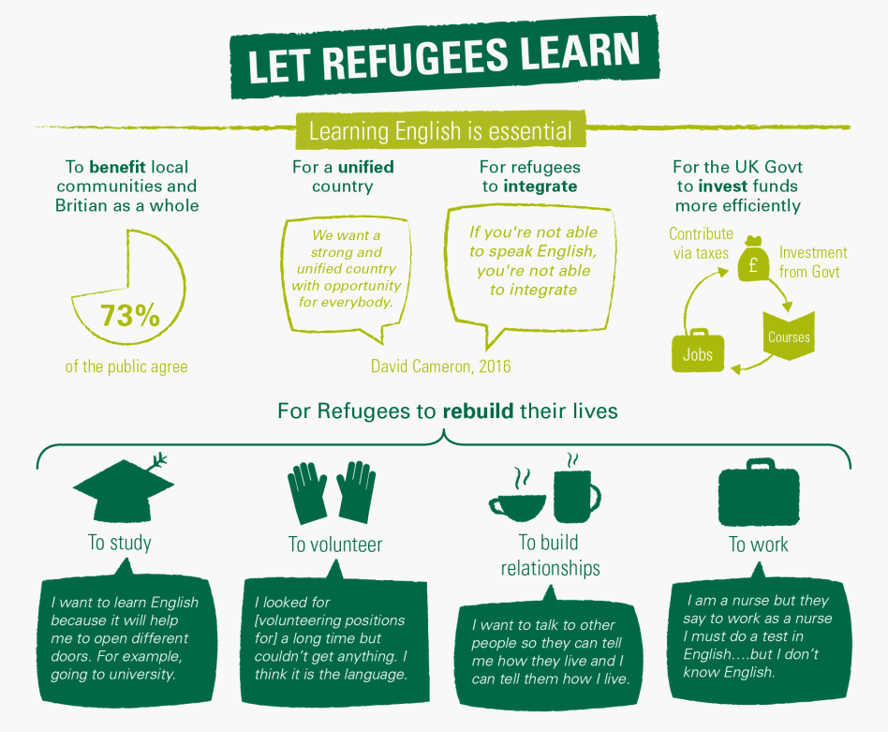

Slide 12
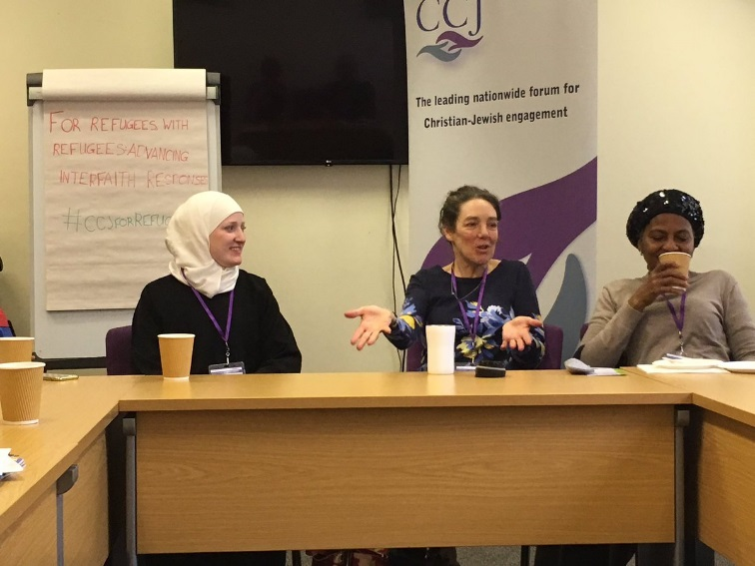
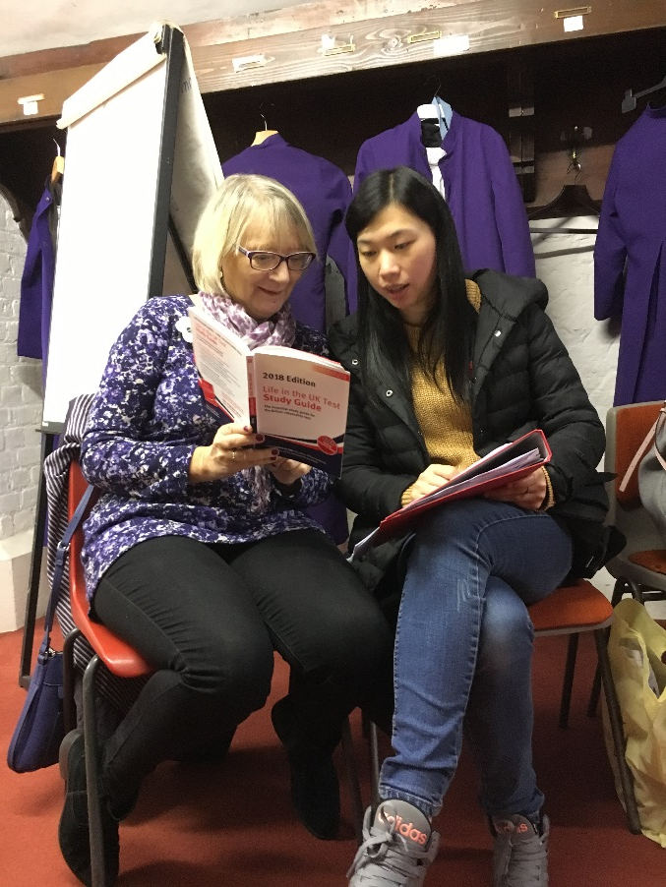
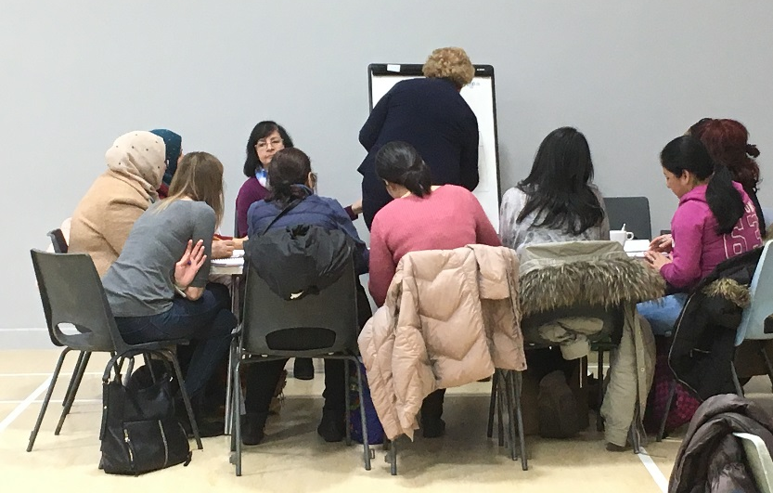
English classes across the Diocese of Southwark
St Peter’s, Walworth
St Margaret’s Lee
Emmanuel, Croydon

Slide 13
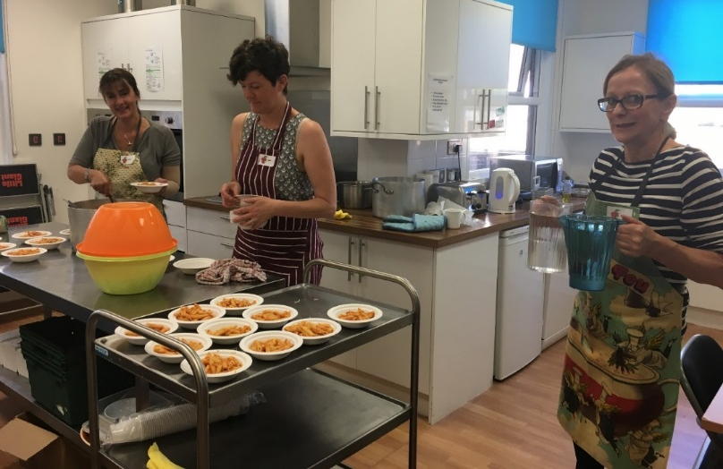
Example
Holiday Hunger
Lunchbox library
Nelly Misenga
Together Southwark Development Officer
Statistics from ‘End Hunger UK’

Slide 14
What does Together Southwark do to ‘seek to transform unjust structures of society’? (4th Mark of Mission)
(Prov. 31:8-9) “Speak up for those who cannot speak for themselves, for the rights of all who are destitute. Speak up and judge fairly; defend the rights of the poor and needy.”
Involving local authorities in the issue of holiday hunger
For a growing number of children across the Diocese school holidays, particularly the long summer holidays mean hunger, isolation and inactivity because families are struggling to put an additional meal on the table.
Together Southwark is advocating for a more coordinated response to the issue of holiday hunger, in order to support children and their families
Notes:
Assisted St Augustine, Croydon, to raise awareness of the issue of holiday hunger at the local level. The church ran Lunchbox Library, the holiday provision scheme supported by Together Southwark
Together Southwark with our partner Big Local Impact held a conference on Holiday Hunger in 2017. Lambeth Council was invited both as member of the panel and of the audience
Lambeth Holiday Hunger Steering Group was created as an outcome, a Councillor is one of its members.
TS is part of Southwark Food Action Alliance, a platform advocating a response to food poverty in the borough of Southwark. Currently working with Public Health Southwark to support the creation of a holiday provision network.
Have started contacts with Lewisham Council as well.

Slide 15
Serious Youth Violence
Example

Slide 16
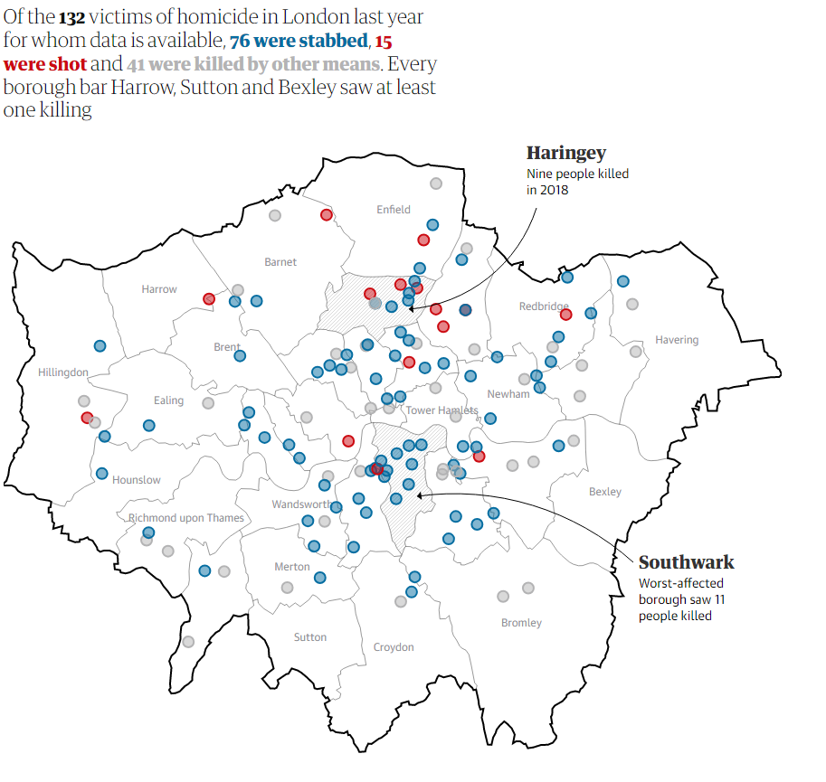

Slide 17
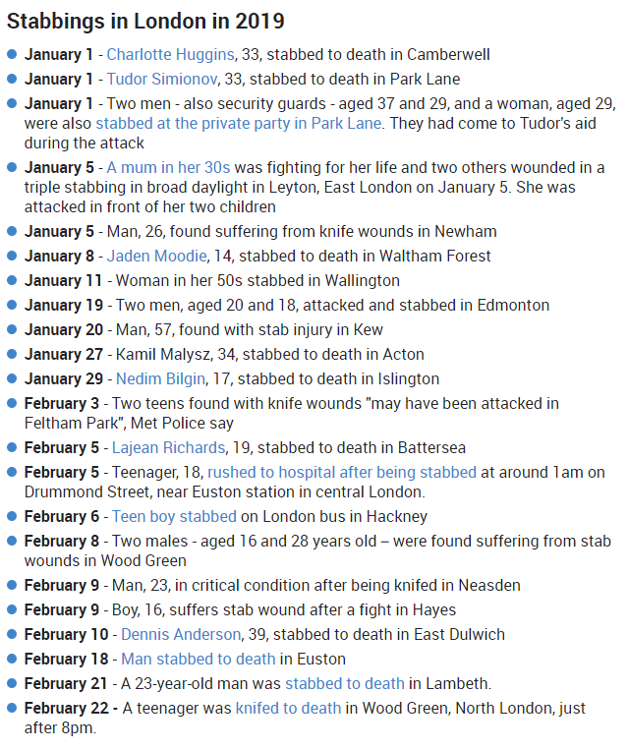
So far in London in 2019 (as of end of May)
75 people stabbed and 27 died.
Of the 27:
The ages of the victims range from 13 to 54.
The majority are under 25years.

Slide 18
How are Churches working together to tackle this issue?
Training
Youth work
Street Pastors
Using church structures
Deaneries/ Diocesan
Supporting families
Prayer
Activism
And more…

Slide 19
How are we challenging and using our own structures in Southwark?
Synod Motion
Fundraising
Diocesan support
Public Spirit
Listening campaigns
Working with Schools

Slide 20
Challenges
What unjust structures affect those in your community/church?
What unjust structures affect those in other parts of the Diocese?
What resources as a deanery do you have that can be used?
What do you think might be the next step for you/ your church/deanery to start challenging unjust structures?

Slide 21
Knife Crime: A response from Richmond & Barnes Deanery
Sponsor a knife bin in the Diocese of Southwark
What’s the cost?
£4,000 manufacture, delivery, 1st year maintenance
£1,535 subsequent annual maintenance
£10,000 funds a bin for 5 years
£5.70 for each person on the electoral rolls of Richmond & Barnes
Can we do it? Discuss in your PCCs, decide at October synod

Slide 22
Questions and Discussion

