Slide 1
Richmond & Barnes Deanery open MEETING
ADAPTING TO MEET THE NEEDS OF LOCAL ROUGH SLEEPERS in THE NEW COVID-19 WORLD
26 November 2020

Slide 2
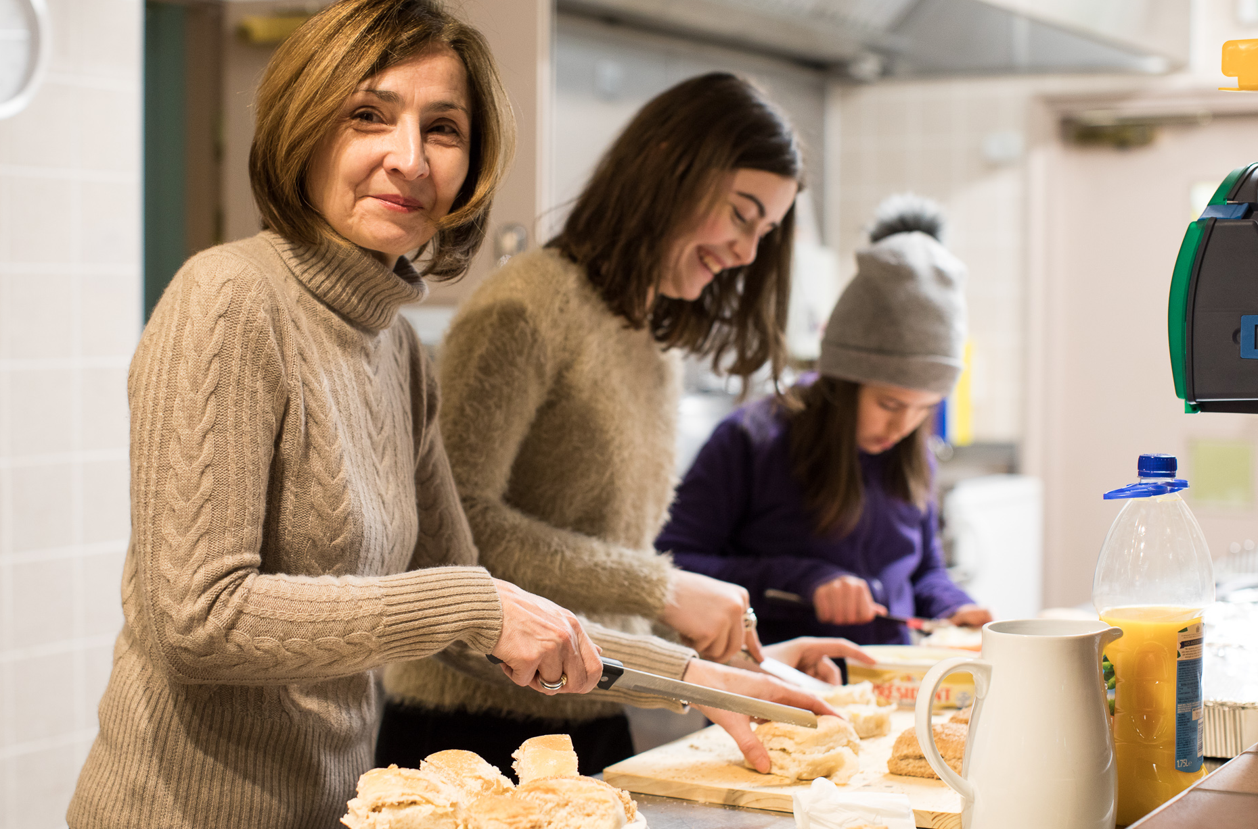
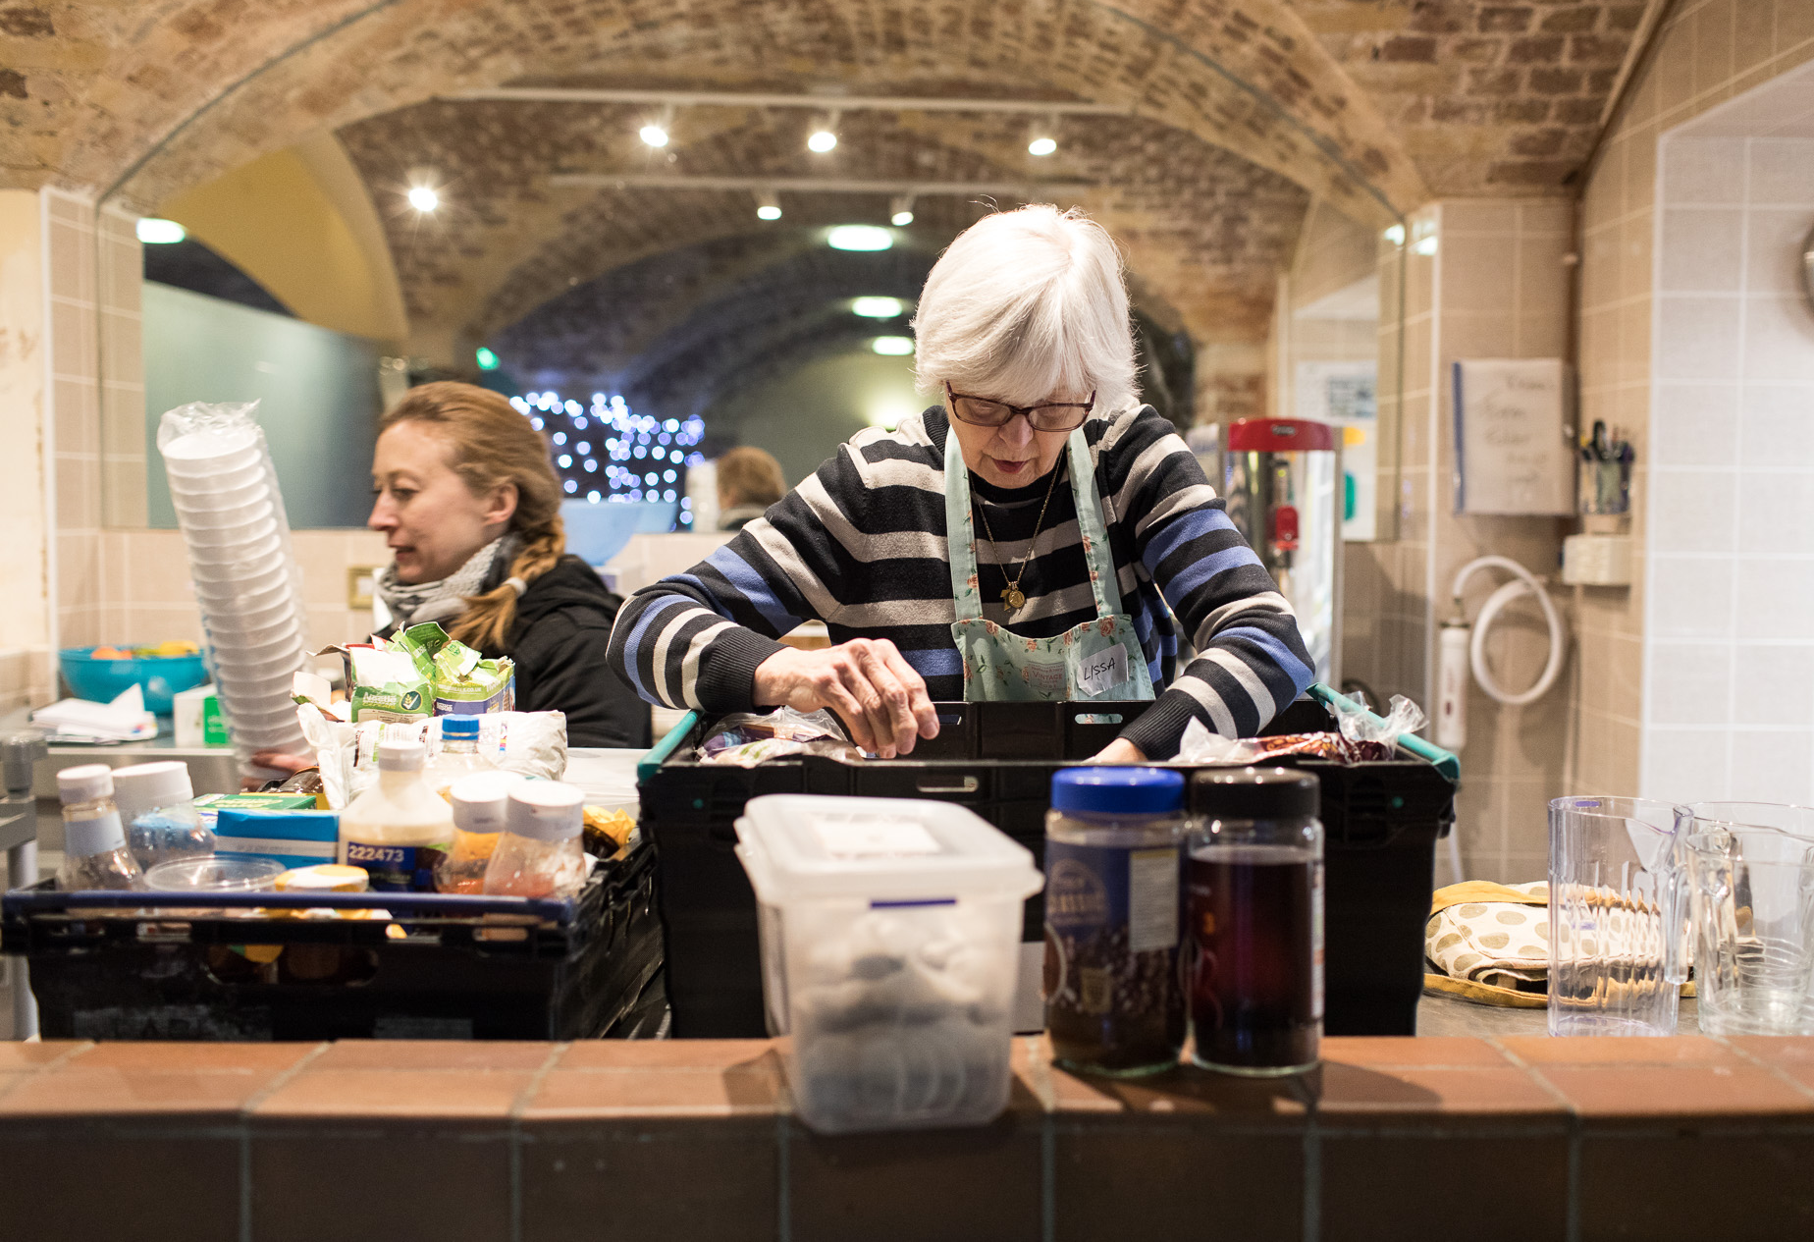
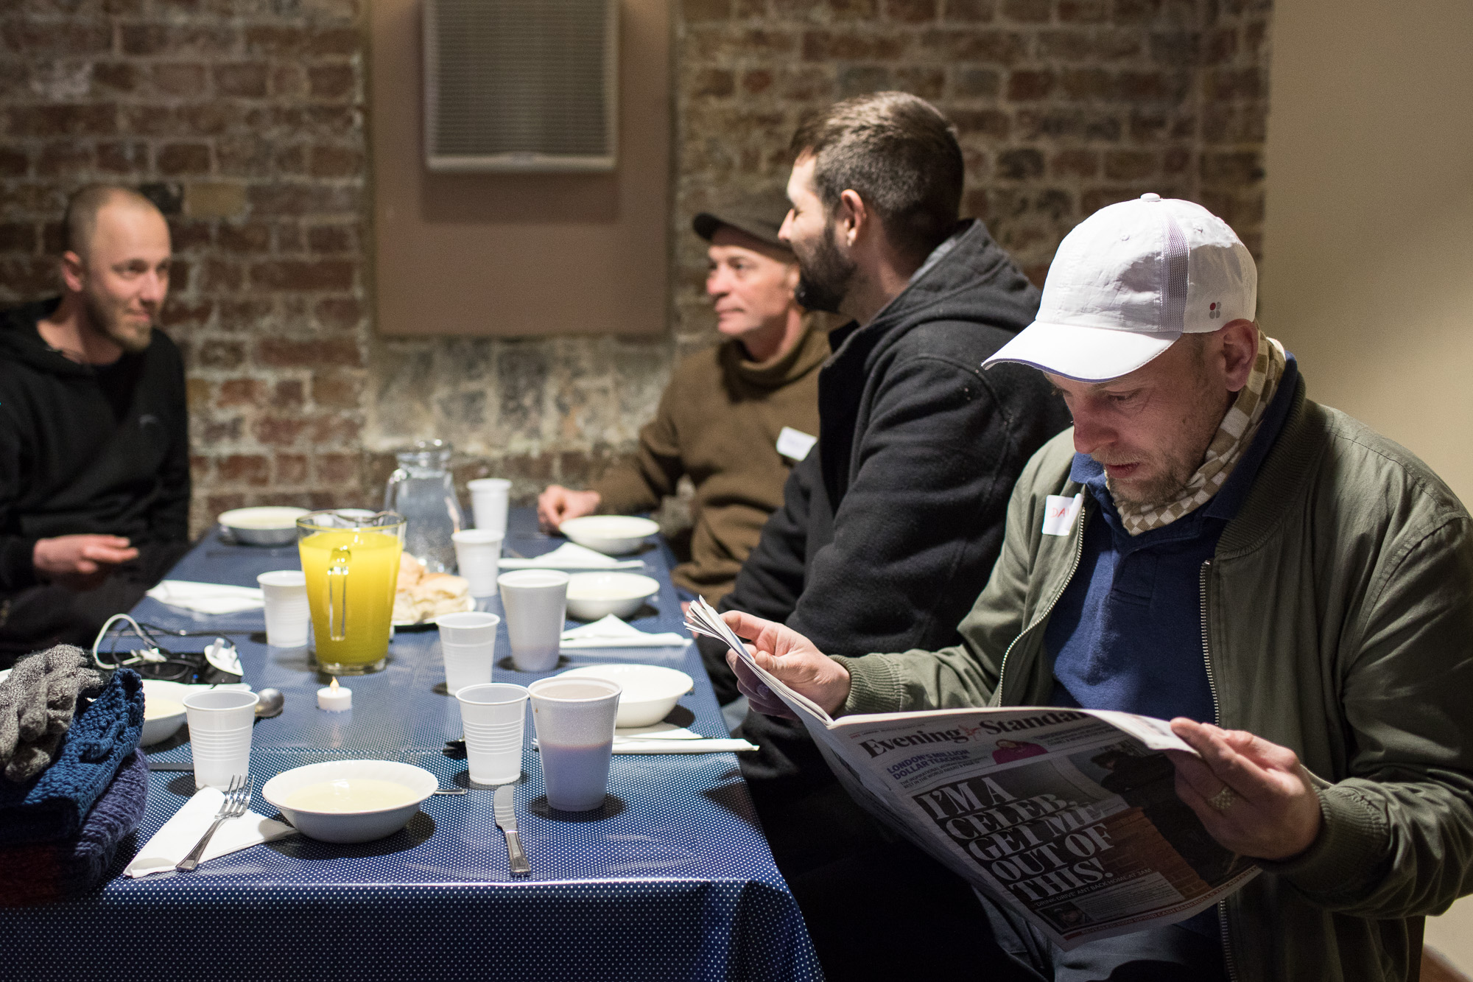
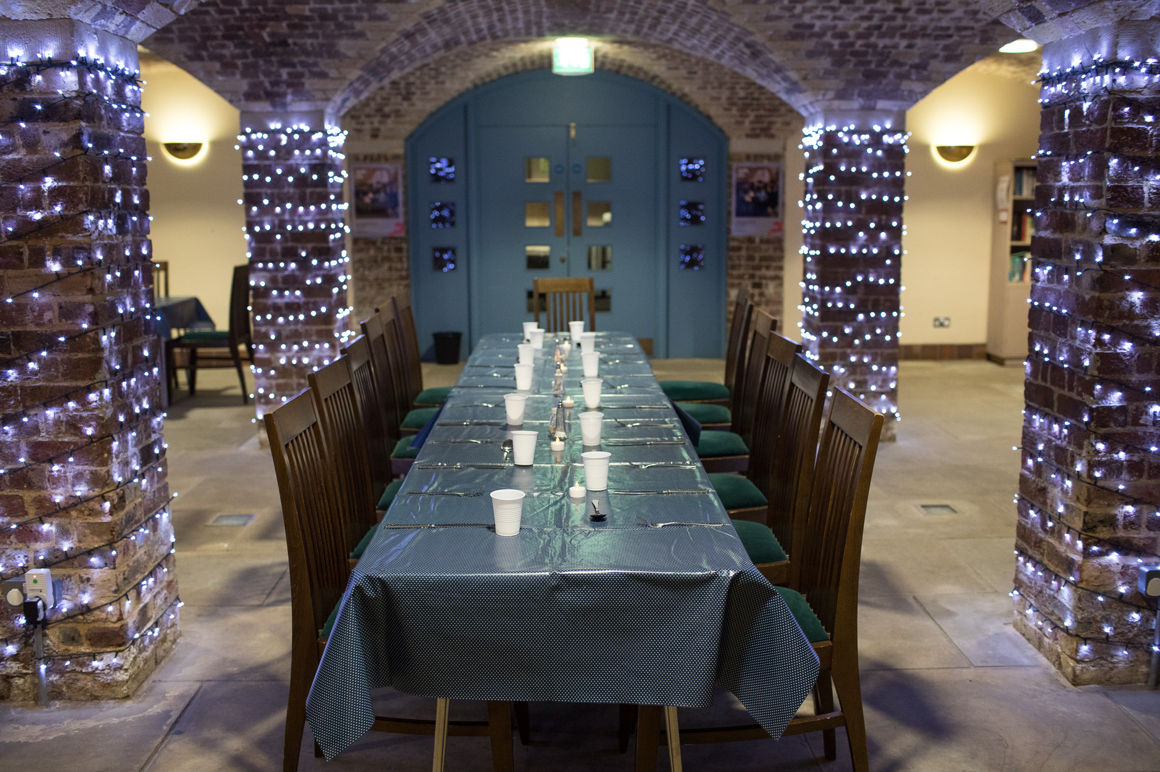
THANK YOU

Slide 3
WHAT we will cover
About Glass Door
Current situation for people experiencing street homelessness
Adapting our services to meet need and manage risk
How you can support
Any questions

Slide 4
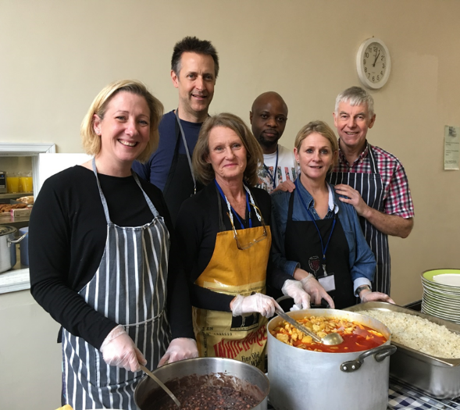
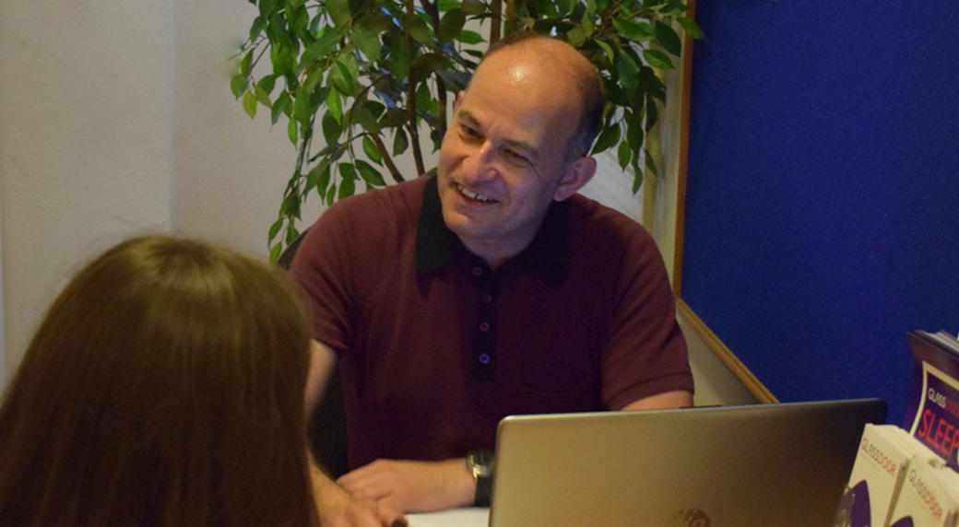
ABOUT GLASS DOOR
20+ years’ experience providing night shelters
Richmond circuit since early 2018
2019-20: 170 spaces per night in 5 shelter circuits, 829 guests
Year-round casework: tailored advice, advocacy and practical assistance
Partnerships with day centres – the Vineyard in Richmond

Slide 5
CURRENT SITUATION
“Everyone in” provided opportunities for many
Currently no “Everyone In 2” planned
Challenges of lockdown:
Nowhere to “stay home” / stay safe / self-isolate
Many services closed or reduced hours
No access to food, water, toilets, showers, electricity
Communal air spaces (= night shelters) disallowed
Economic impact of COVID-19:
People losing jobs and houses already
Worst is yet to come
Notes:
FOI request: 45,000 at risk, 90,000 lost housing, unemployment at 4.8% and rising

Slide 6
ADaPTING TO MEET NEEDs (1)
Early engagement with:
Greater London Authority/MHCLG/ Housing Justice
Partner churches and volunteers
Supportive organisations – hotel chains, schools etc
Guests!
Consultation with public health re COVID-19 safety
Limited numbers of guests and volunteers
COVID-safe practices across all services
Access to rapid pathways for symptomatic guests

Slide 7
ADaPTING TO MEET NEEDs (2)
Re-imagination of our winter services
Community Dinner Service in church venues
1-2 venues in each existing borough
Up to 120 guests each night
Seven nights a week at the Vineyard Community Centre
Two hostels in Paddington/Victoria
Capacity for 92 guests each night
Self-contained bedrooms
Bathrooms shared by pair or small cluster (max 4)
Three meals a day provided
24/7 staff presence
Hostel caseworkers on site 5 days a week

Slide 8
WAYS TO SUPPORT
Promote our services to people sleeping rough
Service hotline: 0208 0166 838 or www.glassdoor.org.uk
Leaflets – request via info@glassdoor.org.uk
Support our Christmas Appeal
Sponsor or fundraise for “A Room at the Inn”
Ventures that support Glass Door
Christmas cards or Christmas wreaths
Donate essential items
Facemasks, books (esp other languages), toiletries, gifts
Top ten ways to make a difference this Christmas | Glass Door Homeless Charity

Slide 9
ANY QUESTIONS?

